Slide 1







TRAFFICIQ - WEB‑BASED INTELLIGENT TRAFFIC LIGHT CONTROL USING FUZZY LOGIC
Jaisurya S - 23MIC0103
Kaleeshwar K - 23MID011
Sankavi M - 23MIC0126
Monika G K - 23MID002
Team - SJT04
Under the guidance of
Prof Sudhakar Pandian R / Professor - Scope
DEPARTMENT - INTEGRATED MTECH COMPUTER SCIENCE / DATA SCIENCE
INSTITUTION:VELLORE INSTITUTE OF TECHNOLOGY
ACADEMIC YEAR 2023-2028

Slide 2




INTRODUCTION
Traffic congestion is a major problem in urban areas due to increasing vehicle population.
Traditional traffic light systems use fixed-time signals, which are inefficient during varying traffic conditions.
To overcome this issue, fuzzy logic is used to design an intelligent traffic light controller that adapts signal timing based on real-time traffic density, similar to human decision-making.

Slide 3


ABSTRACT
This project presents a Fuzzy Logic–based Traffic Light Control System that dynamically adjusts green signal duration according to traffic density. Unlike conventional fixed-time systems, the fuzzy controller uses linguistic variables such as low, medium, and high traffic to make intelligent decisions. The system improves traffic flow, reduces waiting time, and enhances overall traffic efficiency.
Keywords:
Fuzzy Logic, Traffic Control System, Intelligent Systems, Soft Computing, Signal Optimization

Slide 4




LITERATURE REVIEW
Several researchers have proposed intelligent traffic control systems using fuzzy logic to overcome the limitations
of traditional traffic signals. Fuzzy logic is widely used because it handles uncertainty and
imprecision effectively and mimics human reasoning.
Key Studies
Zadeh (1965) – Introduced the concept of Fuzzy Logic
Pappis & Mamdani (1977) – Applied fuzzy logic to traffic signal control
Kaur et al. (2019) – Proposed adaptive fuzzy traffic systems for urban roads
Research Gaps:
Fixed-time signals lack adaptability
High congestion during peak hours
Poor utilization of green time
Summary:
Existing systems do not effectively adapt to real-time traffic conditions. Fuzzy logic provides a flexible and intelligent solution.
Journal References:
IEEE Transactions, International Journal of Soft Computing, Springer Journals

Slide 5




PROBLEM STATEMENT
Background:
Increasing traffic density leads to congestion, delays, fuel wastage, and pollution.
Problem Definition:
Traditional traffic signals operate with fixed timings, which do not respond to real-time traffic variations, resulting in inefficient traffic management.

Slide 6


OBJECTIVES
To design an intelligent traffic signal using fuzzy logic
To reduce traffic congestion and waiting time
To optimize green signal duration
To improve traffic flow efficiency
To demonstrate real-world application of soft computing

Slide 7

METHODOLOGY
01
02
03
Data Collection Tools & Techniques
Traffic density (number of vehicles)
Queue length
Waiting time
Workflow
Traffic Data → Fuzzification → Rule Base → Inference Engine → Defuzzification → Green Time Output

Slide 8


Implementation
Algorithms / Models
Mamdani Fuzzy Inference System
Rule-based decision making
Technologies Used
MATLAB / Python
Fuzzy Logic Toolbox
Simulation tools
Process Flow:
Measure traffic density
Convert values to fuzzy inputs
Apply IF–THEN rules
Generate fuzzy output
Convert to exact green time

Slide 9



EXPECTED RESULTS & DISCUSSIONS
Reduced waiting time
Improved traffic flow
Better utilization of green signals
Adaptive response to real-time conditions
Outputs & Performance Analysis
Dynamic green signal timing
Less congestion at intersections
Improved fuel efficiency
Smooth traffic movement

Slide 10
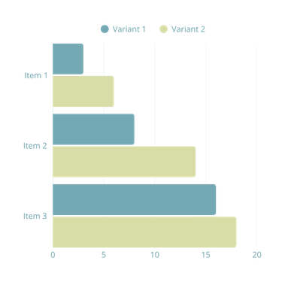
GANTT CHART
Workflow :
Week 1–2: Problem analysis
Week 3–4: Literature review
Week 5–6: System design
Week 7–9: Implementation
Week 10–11: Testing
Week 12: Documentation & review

Slide 11
CONCLUSION
Findings
Fuzzy logic effectively improves traffic signal control by adapting to real-time conditions.
Contributions
Intelligent traffic management
Reduced congestion
Practical application of soft computing

Slide 12
FUTURE SCOPE
Enhancements
Integration with IoT sensors
AI-based learning systems
Smart city implementation
Further Research
Multi-junction coordination
Emergency vehicle prioritization

Slide 13






THANK
YOU

